Slide 1
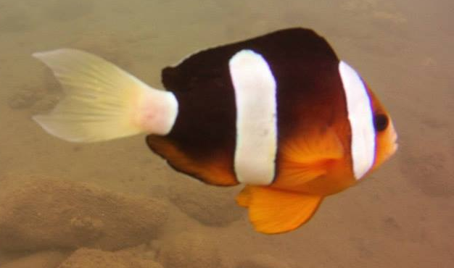

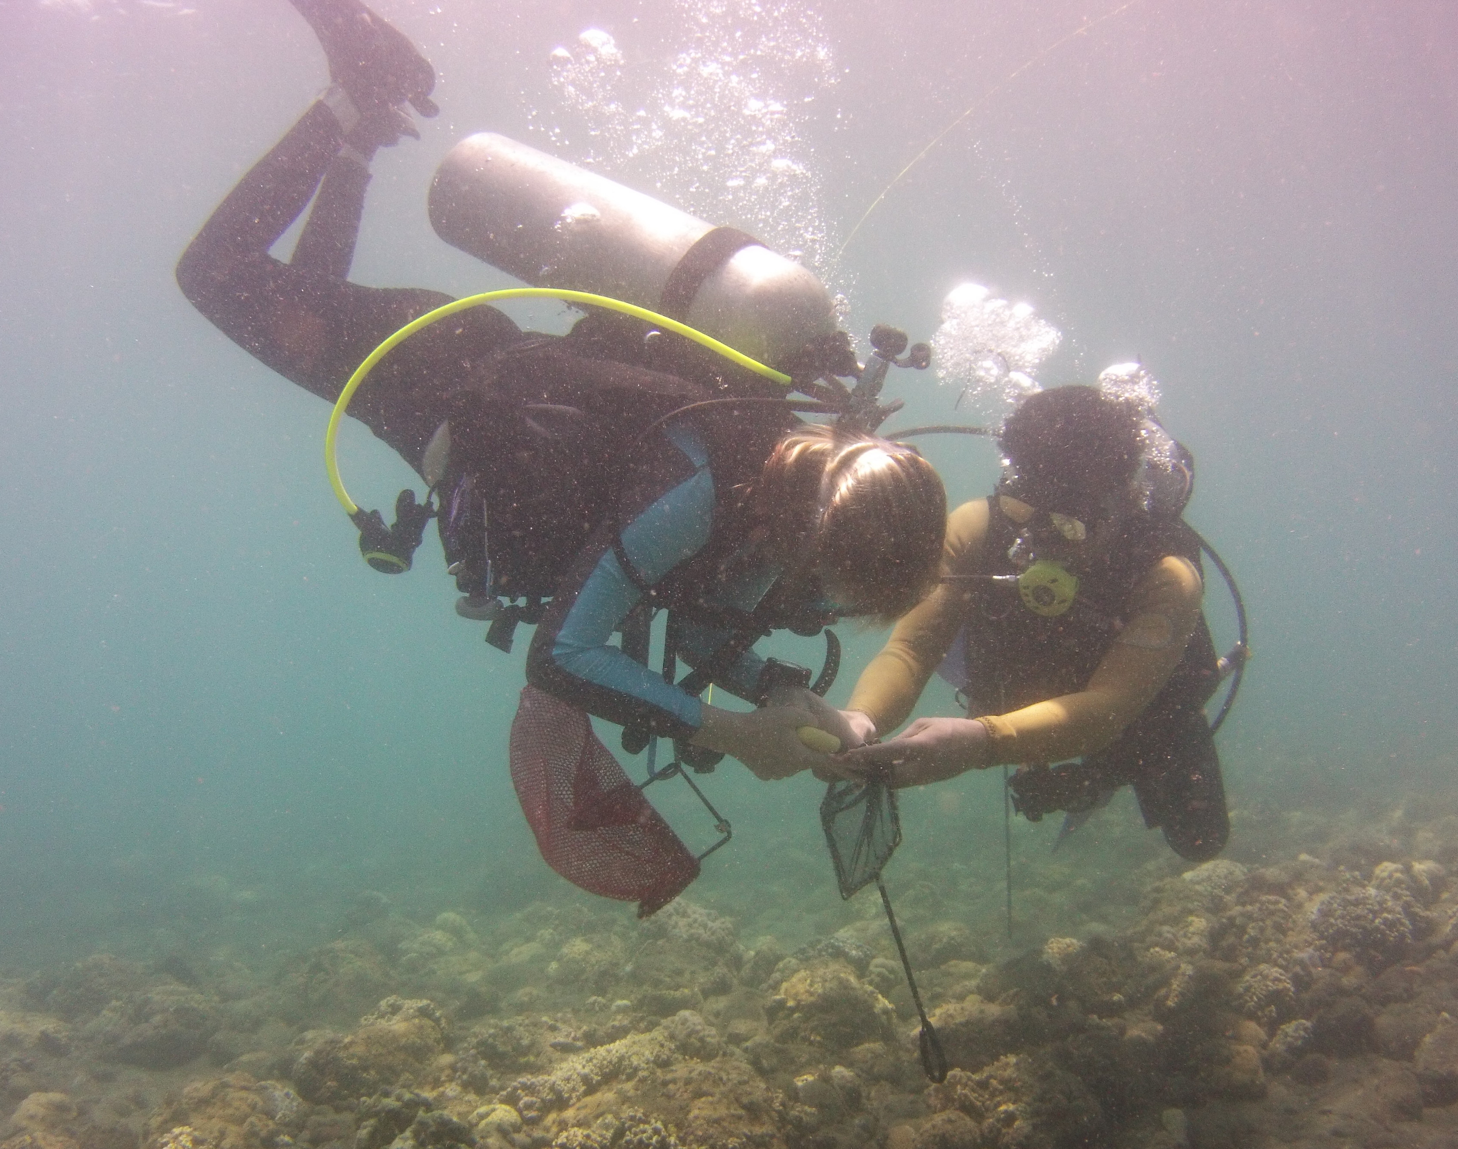
Who’s your daddy: using ddRADSeq to explore survival and dispersal
M i c h e l l e S t u a r t & M a l i n P i n s k y
michelle.stuart@rutgers.edu
http://pinsky.marine.rutgers.edu
NSF #OCE-1430218
This study examines a metapopulation of clownfish, Amphiprion clarkii, in the Philippines.
ddRADSeq is a cost- and time-efficient method for genotyping.
~192 SNPS
~1000
loci
~20
Micro
satellites
This method genotypes 1000s of SNPs in 1000s of samples.
ddRADSeq allows us to track an individual through a lifetime to measure:
Survivorship
Growth
Reproduction
Retention and dispersal of offspring
Recaptured fish are identified based on genotypes.
 | Fish Genotyped | Fish Recaptured
2013 | 552
2014 | 403 | 12
Sitio Baybayon reef, matching colors are fish recaptures, average distance was 48 m.

